Slide 1
November 19, 2023
WORLD DAY OF THE POOR
Who are the poor?

Slide 2
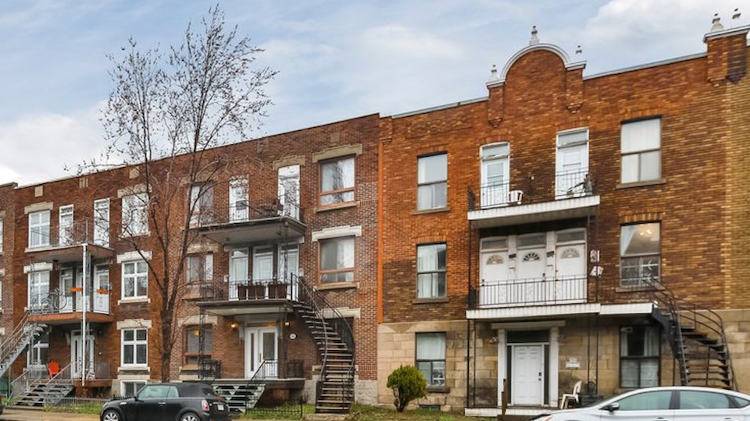
Home visits

Slide 3
Friendly visits

Slide 4
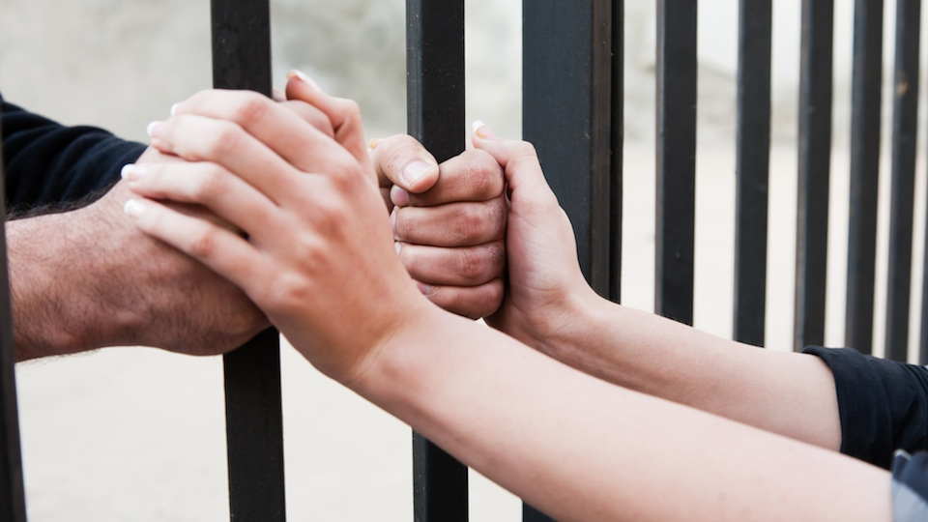
Visits to prisoners

Slide 5
Soup Kitchens

Slide 6
Food banks

Slide 7
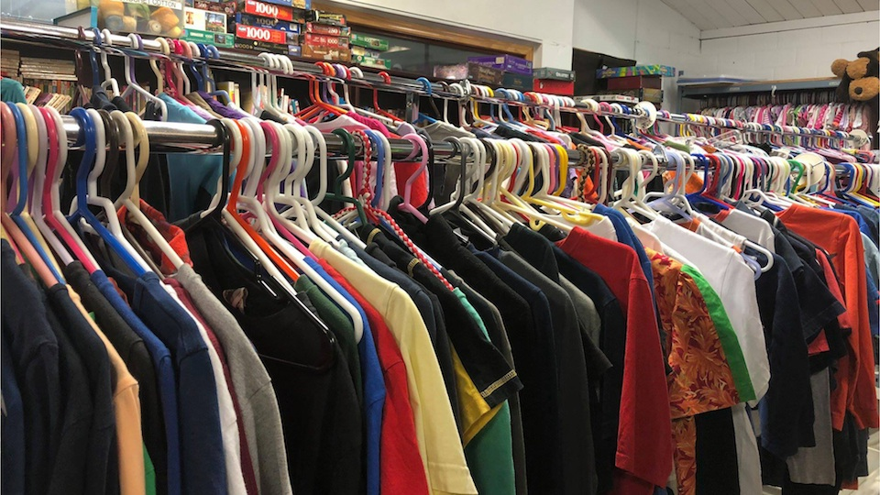
Material help
Clothes & accessories

Slide 8
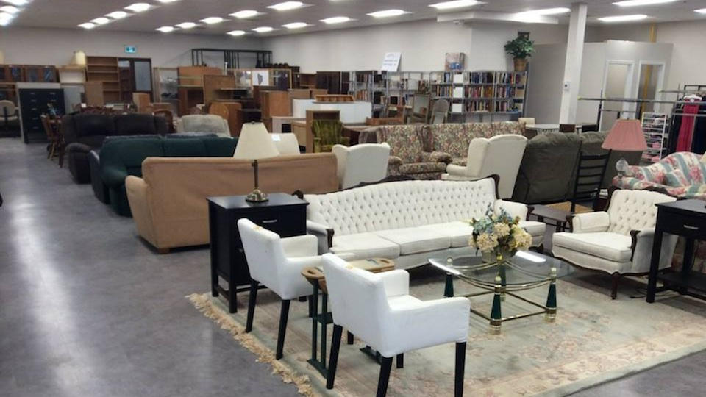
Material help
Furniture

Slide 9
Educational support
School supplies

Slide 10
Educational support
Scholarships

Slide 11
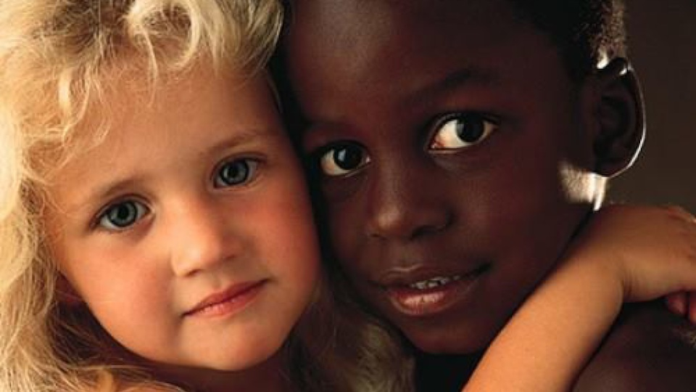
Help to
Refugees & immigrants

Slide 12
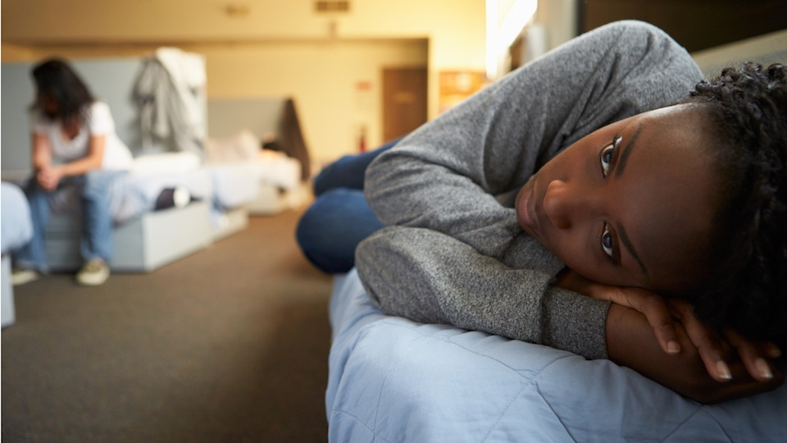
Shelters
homeless, single mothers, abused persons

Slide 13
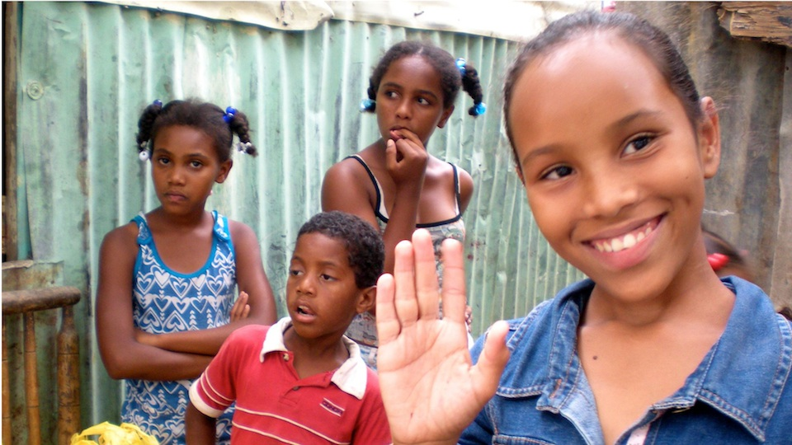
Twinning with
other countries

Slide 14
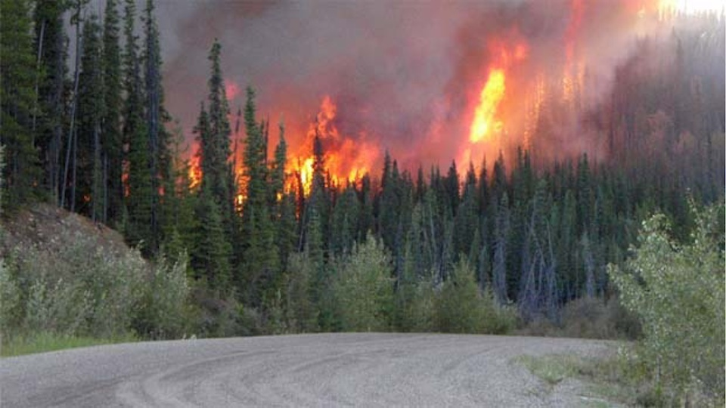
Emergency relief
National & International
Natural disasters and humanitarian disasters

